Slide 1

Nvidia Large LANGUAGE MODELs Comparision

Slide 2
Introduction
When a developer wants to experiment with Large Language Models, one may usually start with a tutorial that uses either an OPENAI model or a Hugging Face model. In these tutorials, one model is chosen to demonstrate the capabilities of model.
There are many models that a developer can pull from the hugging face repository but requires refactoring of code to fit different models.
What if a developer wants to test multiple models that perform the same task such as text-to-text generation and it make it easy to use for the user to switch between models to test how the same prompt works with different models? What if you want to benchmark these models?

Slide 3
Nvidia Foundation Models
Nvidia gives the ability for the developer to interact with these model through the Nvidia AI Foundational Models API. This API is available in shell, node, python and go programming languages in streaming or non-streaming API formats.
https://catalog.ngc.nvidia.com/ai-foundation-models
In order to generate an API key, make an account and then click on the model. From there, click the API tab and click generate API to get your API key. Then you can select your streaming format and programming language code. The developer then can use that code to integrate with their code base.

Slide 4
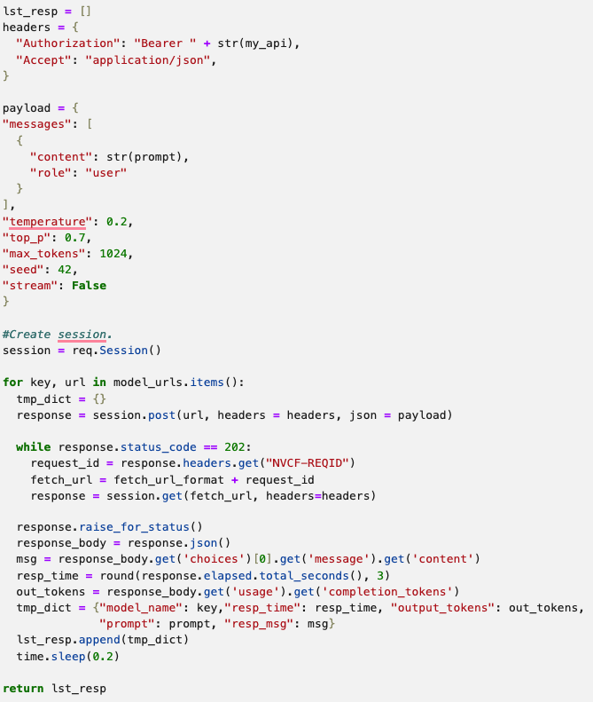
Code Demonstration
 | The code to the left is a modified non-streaming API version of what is found in the Nvidia Catalog. Each model uses the same payload configuration. The model names and model urls are stored in a dictionary in which the code loops through each model to make an API call to return the response. It then extracts the relevant fields into a dictionary which is then appended to a list. The result is a list of dictionaries each containing the model response. This result of the function can be used to feed multiple prompts from a list to generate a pandas dataframe that contains the model name, response time, output tokens, prompt used and generated message. Then a pandas “groupby” by model name is invoked to create a dataframe that contains the aggregated stats for output tokens and response time.

Slide 5
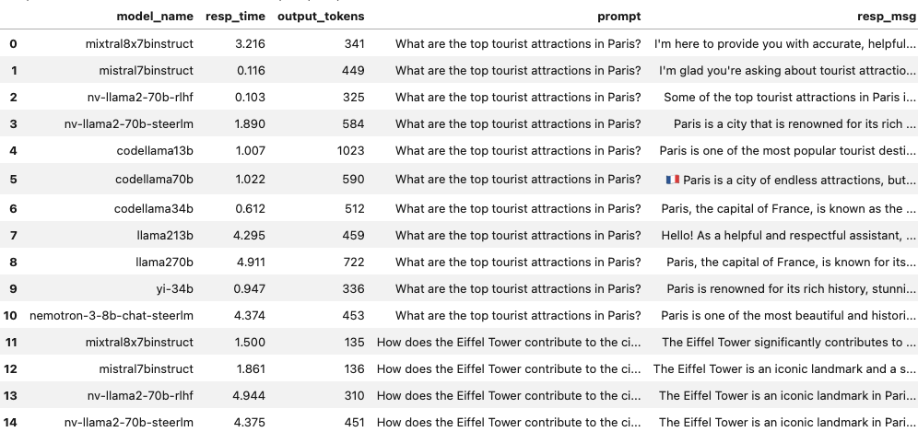
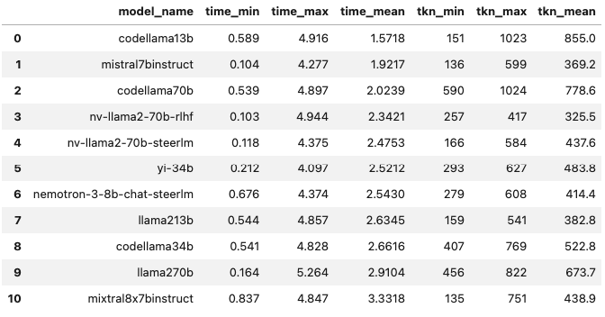
Results
LLM Prompt Results | LLM Statistical Results

Slide 6
Additional Notes
All the models tested was done with a token length of less than 30 for the input prompts.
It take approximately 2 mins for each prompt to go through models sequentially.
Async with aiohttp changes some models’ status code to 200 instead of 202 which required factoring of code to make it.
Async with aiohhtp caused some models to return no content despite returning a status code of 202. This is not restricted to a particular model as it changes with each run.
An extension to the code’s functionality would be to add Information Retrieval metrics to test the ”correctness” of the models.

Slide 7
Conclusion
In this short presentation, we looked at using the API interface of Nvidia AI Foundational Models and benchmarking the performance of eleven text-to-text models.

